Slide 1
ANALYSIS FOOD & DRUG ADMINISTRATION USING SQL & MICROSOFT POWER BI
Graded Project on SQL for Data Science
Created by: Aneesh sharma
ABADS-Batch-11

Slide 2
OBJECTIVES:-
Business objective.
Data understanding.
Project objectives & observations using SQL.
Project objectives & observations using Power bi.

Slide 3

BUSINESS OBJECTIVE :-
The FDA's mission is to protect and promote public health by ensuring the safety and effectiveness of a wide range of products and substances.
To study the trends of number of approved drugs with successful forms over the years.

Slide 4
DATA DESCRIPTION :-
Applno :- The FDA assigned number to the application.
Approval Date:- The date the product was approved as stated in the FDA approval letter to the applicant. The format is Mmm dd, yyyy.
Therapeutic Equivalence (TE) Code:-The TE Code indicates the therapeutic equivalence rating of generic to innovator Rx products.
Product Number:-The FDA assigned number to identify the application products. Each strength is a separate product. May repeat for multiple part products. Format is nnn.
Dosage Form:-A dosage form is the physical form in which a drug is produced and dispensed, such as a tablet, a capsule, or an injectable.
FDA Action Date:-The action date tells when an FDA regulatory action, such as an original or supplemental approval, took place.
Therapeutic Equivalents:- Approved drug products are considered to be therapeutic equivalents if they are pharmaceutical equivalents for which bioequivalence has been demonstrated, and they can be expected to have the same clinical effect and safety profile when administered to patients under the conditions specified in the labeling.
:-

Slide 5


PROJECT OBJECTIVES & OBSERVATIONS USING SQL
.
Task 1: Identifying Approval Trends:-
Determine the number of drugs approved each year and provide insights into the yearly trends.
Identify the top three years that got the highest and lowest approvals, in descending and ascending order, respectively.

Slide 6

PROJECT OBJECTIVES & OBSERVATIONS USING SQL
.
Explore approval trends over the years based on sponsors.
Rank sponsors based on the total number of approvals they received each year between 1939 and 1960.

Slide 7

PROJECT OBJECTIVES & OBSERVATIONS IN SQL
.
Task 2: Segmentation Analysis Based on Drug Marketing Status:-
Group products based on Marketing Status. Provide meaningful insights into the segmentation patterns.

Slide 8
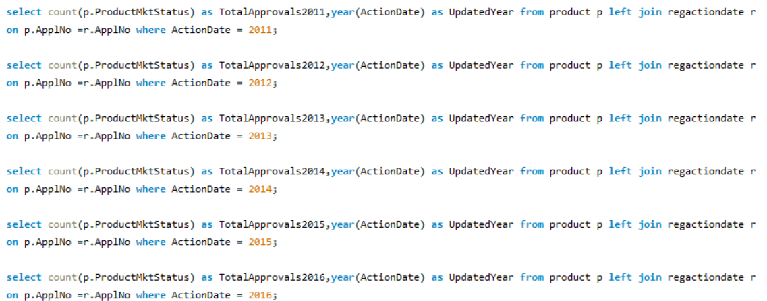
PROJECT OBJECTIVES & OBSERVATIONS IN SQL
.
Calculate the total number of applications for each Marketing Status year-wise after the year 2010.

Slide 9

PROJECT OBJECTIVES & OBSERVATIONS IN SQL
.
Identify the top Marketing Status with the maximum number of applications and analyze its trend over time.
Task 3: Analysing Products:-
Categorize Products by dosage form and analyze their distribution.

Slide 10
PROJECT OBJECTIVES & OBSERVATIONS IN SQL
.
Calculate the total number of approvals for each dosage form and identify the most successful forms.
Investigate yearly trends related to successful forms.

Slide 11
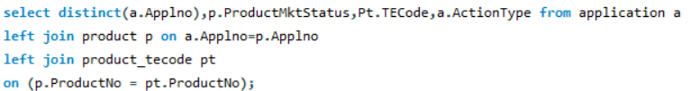
PROJECT OBJECTIVES & OBSERVATIONS IN SQL
.
Task 4: Exploring Therapeutic Classes and Approval Trends :-
Analyse drug approvals based on therapeutic evaluation code (TE_Code).
Determine the therapeutic evaluation code (TE_Code) with the highest number of Approvals in each year.

Slide 12
PROJECT OBJECTIVES & OBSERVATIONS IN SQL
.
Highest approvals in the year 1984.
Top 3 years with in ascending were 1939,1941& 1942.
3 years in descending order were 2016,2015 & 2013.
3D IMAGING DRUG has the highest rank in sponsors.
3M sponsor applicant has highest rank from 1939 to 1960
Product marketing status 1 has higher number of approvals.
Highest number of approval for product mkt status was in 2013.

Slide 13
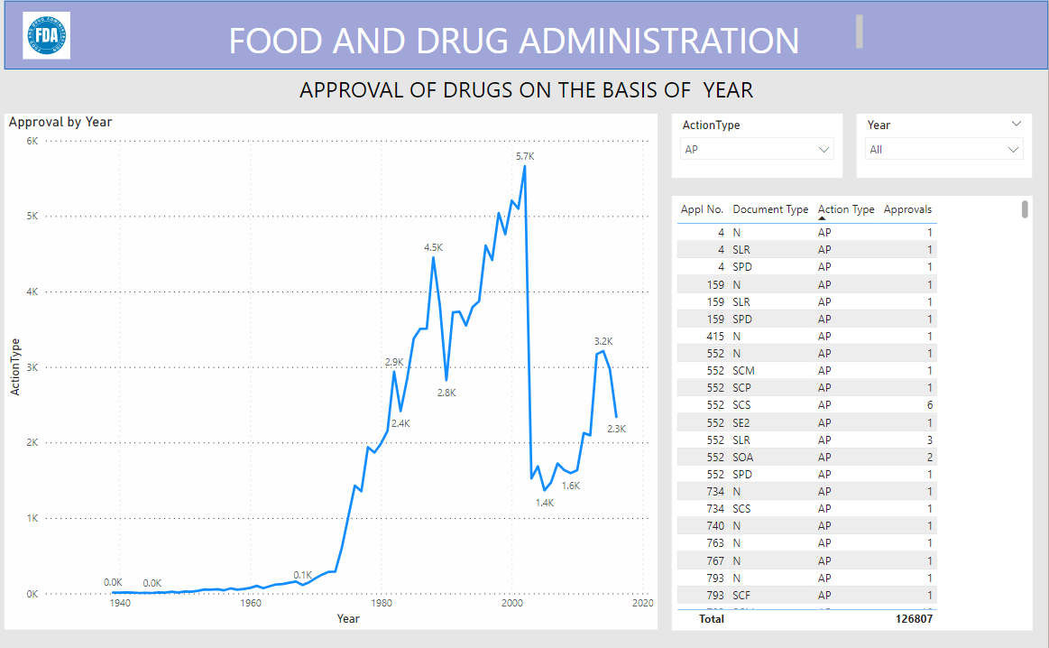
PROJECT OBJECTIVES & OBSERVATIONS IN MS POWER BI
.
Visualize the yearly approval trends of drugs. Highlight any significant patterns and/or fluctuations, if any.

Slide 14
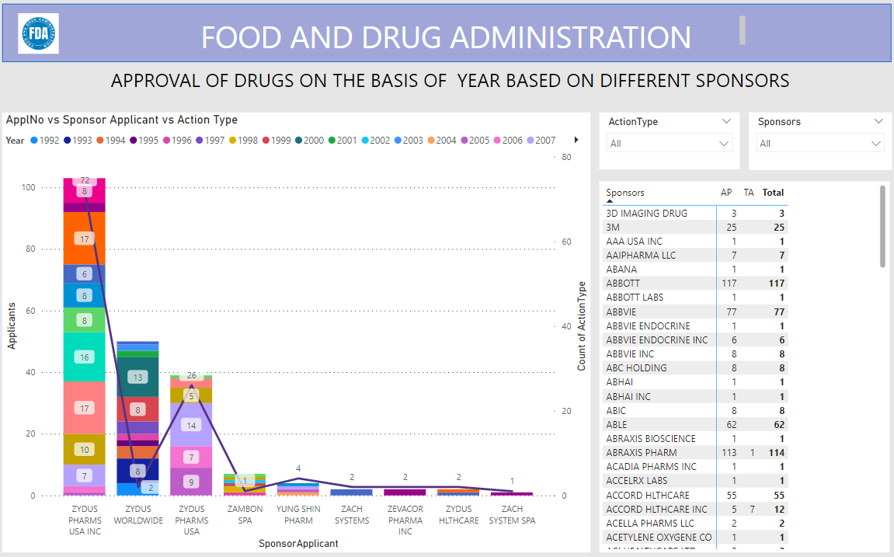
PROJECT OBJECTIVES & OBSERVATIONS IN MS POWER BI
.
Explore approval trends over the years based on different sponsors. Uncover patterns and changes in approval rates among sponsors.

Slide 15
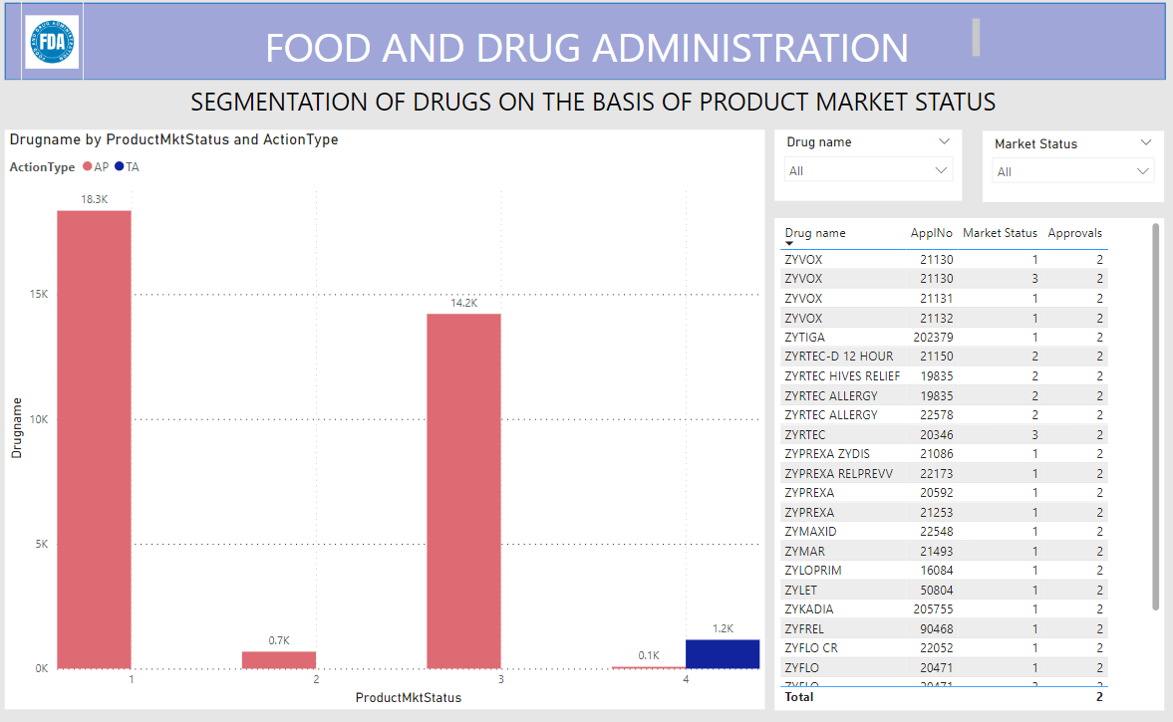
PROJECT OBJECTIVES & OBSERVATIONS IN MS POWER BI
.
Visualize the segmentation of products based on Marketing Status.

Slide 16
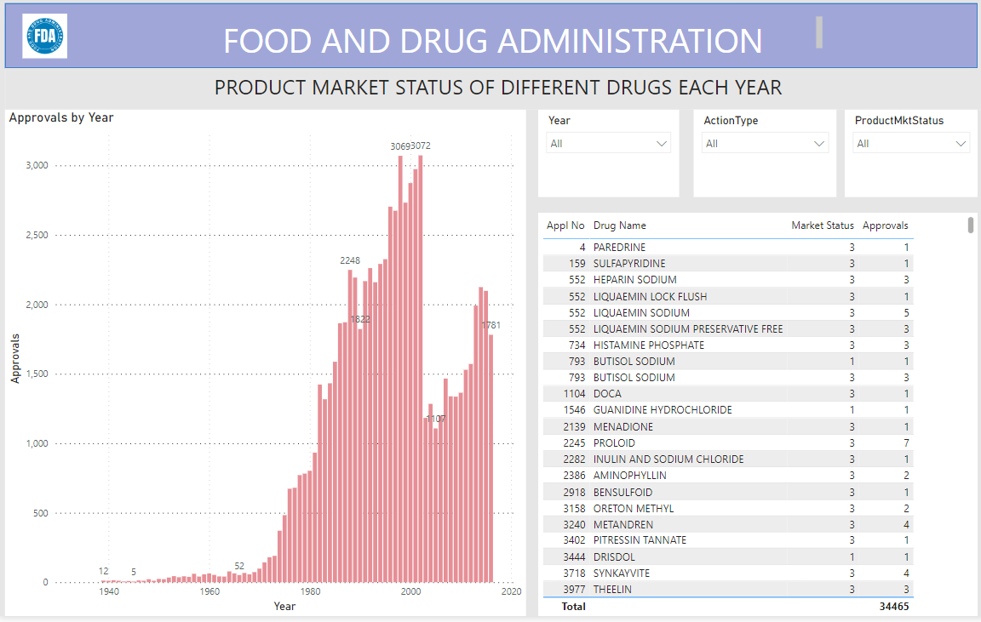
PROJECT OBJECTIVES & OBSERVATIONS IN MS POWER BI
.
Show the total number of applications for each Marketing Status. Enable users to filter by years and Marketing Status for detailed analysis.

Slide 17
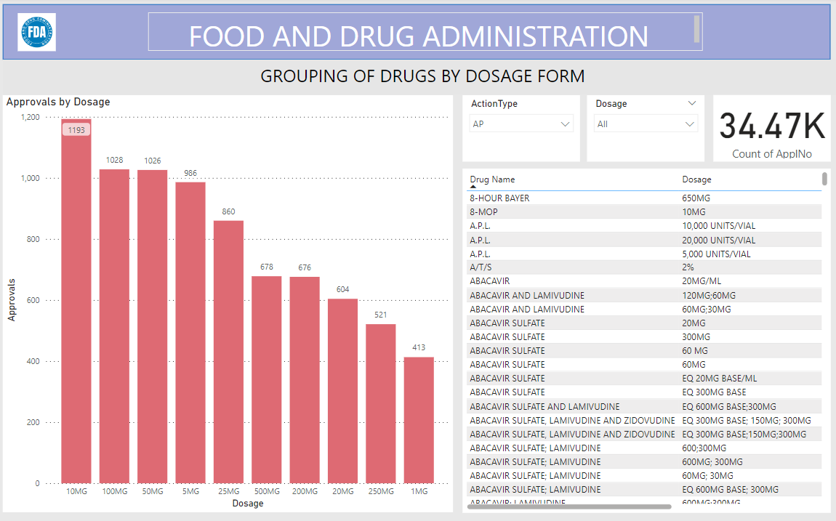
PROJECT OBJECTIVES & OBSERVATIONS IN MS POWER BI
.
Analyze the grouping of drugs by dosage form. Visualize the distribution of approvals across different forms. Identify the most successful dosage form.

Slide 18
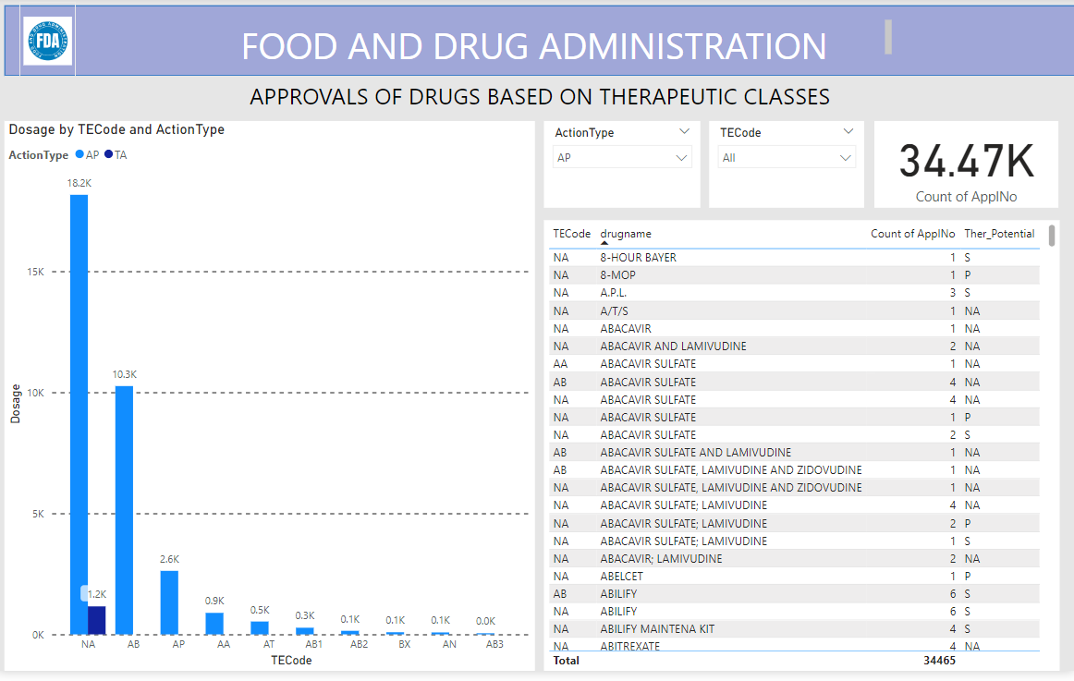
PROJECT OBJECTIVES & OBSERVATIONS IN MS POWER BI
.
Visualize drug approvals based on therapeutic classes. Identify classes with the highest number of approvals.

Slide 19
PROJECT OBJECTIVES & OBSERVATIONS IN MS POWER BI
.
Highest approvals were recorded in 2002 which were 5.7 k & lowest approvals were in 1940 which were only 14.
Sponsor applicants which has higher approvals is ZYDUS PHARMS USA INC where as lowest were ZACH SYSTEM SPA.
Product Marketing status 1 has highest number of approvals.
In year 2002,Product Marketing status 3 & 1 has highest number of approvals.
10Mg consists of higher number of approvals.

Slide 20

THANKYOU

